Slide 1
MYNTRA ANALYSIS

Slide 2
INTRODUCTION
It is an e-commerce company that sells fashion and products for men, women and children.
Founded in 2007-2008 previously it was B2B company
Latter it gets boomed as a e-commerce website
Previously it allowed customers to personalized products like T-shirts,mugus etc.,
Latter myntra moved from pesonalization and offered products from 350 indian and international brands

Slide 3
FLIPKART ACQUIRED
FAILURE MODEL
2007
2015
2017
2014
2016
FOUNDED
APP ONLY MODEL
REPORTED 151.20 CRORE LOSS

Slide 4
PROBLEM STATEMENT
To assess myntra’s online reputation,to identify emerging trends and provide stratergic recommendations to improve myntra position by leveraging insights from social media and customer reviews.

Slide 5
BUSSINESS MODEL
ONLINE MARKET PLACE: sale of fashion items by third-party vendors. Revenue generation-suppliers.
CUSTOMER-CENTRIC: collaborations and investments.
WELL KNOWN BRANDS AND NEW TRENDS: flipkart move made it possible.

Slide 6
HOW MYNTRA MAKES MONEY:
TOTAL REVENUE:45,092
LOGISTIC SERVICE: 44.2% MARKET PLACE SERVICES:39.5%
ADVERTISEMENT SERVCES: 11.9%
OTHER INCOME : 2.97%
OTHER OPERATING REVENUE:1.49%

Slide 7
REVENUE MODEL
Fy 22
Rs 3,501 crores
Losses :Rs 597.6 crore
Fy 23
4,375 crores(25%)
Losses:784.6 crore(31%)

Slide 8
COMPETITORS
Ajio: A fashion portal owned by reliance.
Nykaa: A beauty and e-commerce platform.
Amazon: A online shopping website.
Tata clip: An e-commerce market platform.
Fynd: An fashion e-commerce platform.
Koovs: An online fashion player .

Slide 9
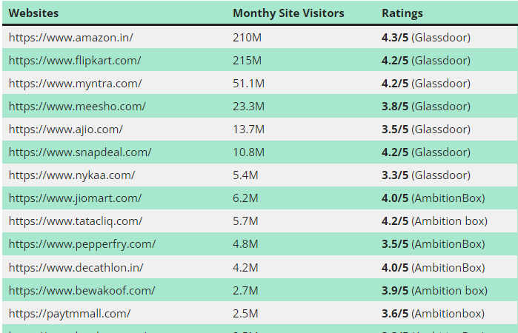

Slide 10
PERFORMANCE
CLOUD: microsoft Azure cloud platform to store the data
Azure is a secure platform with variety of secure features
Cost effective with variety of pricing options.
Through this we can make data analytics to meet the needs.

Slide 11
CUSTOMER SENTIMENT ANALYSIS
POSITIVES: Wide variety products, reasonable prices, trust, affordable prices, easy browsing experience, cash on delivery, regular sales and discount, strong brand partnership, mobile app .
NEGATIVES: customer service, product quality, delivery, non –affordable, limited selection, pricing, return policies, lack of transparencies in shipping policies, lack of loyalty rewards for repeat customers.

Slide 12
SWOT ANALYSIS
STRENGTH
STRONG BRAND RECOGNITION: myntra is the most recognized online fashion brand. This recognition gives it a competitive advantage and ensures a solid customer base.
EXCLUSIVE BRANDS AND COLLABORATIONS: Myntra has exclusive partnerships and collaborations with international and domestic brands and designers.
They have also launched exclusive collections with celebrities which adds to the brand’s uniqueness.

Slide 13
WEEKNESS
OPERATIONAL CHALLANGES: E-commerce operations can face logistical challenges, including delivery delays, mishandling of goods or stock unavailability.
HIGH RETURN RATES: Fashion E-commerce platforms generally tend to experience higher return rates than other sectors. This can be due to sizing issues, difference in actual product appearance vs online images or customer dissatisfaction.
SUPPLY CHAIN LIMITATIONS: Although Myntra has a well-established supply chain, disruption, be it due to external factors like internal inefficiences.

Slide 14
OPPORTUNITIES
INTERNATIONAL EXPANSIONS: while myntra has primarily focused on the Indian market, there is a potential to tap into neighbouring countries or other market where online fashion segment is still emerging.
DIVERSIFYING PRODUCT OFFERINGS: Myntra can further expand its product categories, venturing into areas like luxury fashion, sustainable fashion, or specialized segments like ethnic wear etc.,
SUPPLY CHAIN OPTIMIZATION: Investing in technology to optimize supply chains can result in quicker deliveries, better inventory management, and educed operational cost

Slide 15
THREATS
INTENSE COMPETITION:The online fashion retail market in India is highly competitive . Players like Amazon, Ajio, and others providing service for same customer base, and new entrants can also increase competition further.
RAPID TECHNOLOGICAL CHANGES: The e-commerce lanscape continually evolves, and staying behind in technological advancement can affect user experience and overall competitiveness.
SHIFT IN CUSTOMER PREFERENCE: The fashion industry is notably fickle, with trends changing rapidly. An inability to keep up with these changes can result in in lost sales and reduced market share.

Slide 16
CUSTOMER REVIEW ANALYSIS
HIGH IMPACT CUSTOMER REVIEWS:
1.people are requesting haul from other brands like Meesho, Flipkart, and Nykaa.
2. some of the viewers appreciate the timely delivery.
3.some of the viewers express the product quality is good as like they expected before.

Slide 17
LOW IMPACT COMMENTS
DELAYED DELIVERY: Some customers felt bad for the delayed deliveries.
Customer service: Some customer express their sadning for poor customer service.

Slide 18
STRATERGIC RECOMMENDATIONS
INFLUENCER COLABORATIONS: Need some influencer collaborations to increase the traffic.
RECOMMENDATIONS: need to recommend the products as per the customers preference.
MERGE WITH THE TREND: As the word trend is always evolve because of innovation so myntra should join with the trend.
INNOVATIONS: A marketing can make a trend as it caters mainly to the youth it serve better trend to the current generation.

Slide 19
FOCUS: While reviewing the customers comment we can observe that there is lack of customer service responses as they are the face of the company they should be trained, instructed and fulfill their needs because they are mentallity will be the reflection of company’s metallity.
DELIVERY: As the delivery is the direct interaction with the customers there is a need in increasing delivery hubs to cover the non-service areas and to increase the customers.

Slide 20
THANK YOU

